Slide 1
2024 Class A1 – Humanities Section – History & Archaeology
Overall section members: 319 Overall foreign members: 15 Overall female members: 72

Slide 2
2024 Class A1 – Humanities Section – History & Archaeology
Michael Alram Kunsthistorisches Museum Vienna Austria | Ancient and medieval numismatics Pre-Islamic monetary history of Iran, Central Asia and the Indo-Iranian borderlands

Slide 3
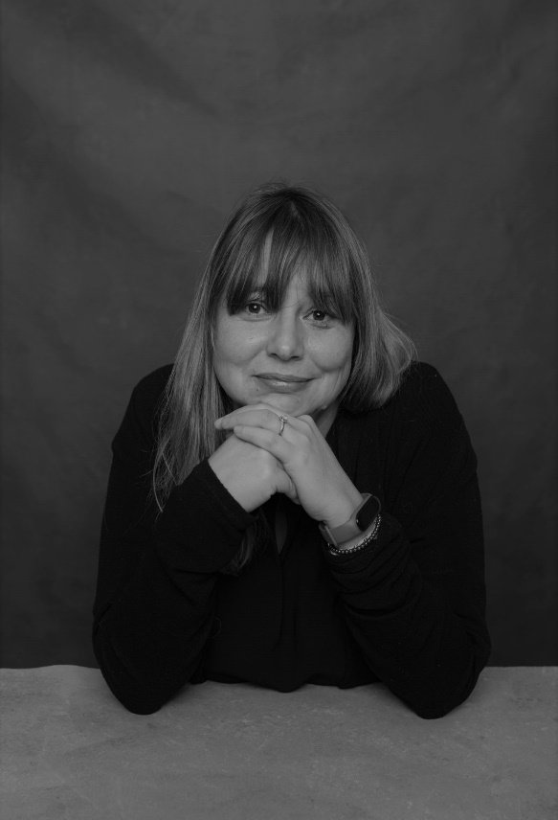
2024 Class A1 – Humanities Section – History & Archaeology
Marta Arzarello Università di Ferrara Italy | First European peopling Prehistory Excavation methods Middle palaeolithic Firsts islands peopling Lower palaeolithic Lithic technology

Slide 4
2024 Class A1 – Humanities Section – History & Archaeology
Jennifer Anne Baird University of London United Kingdom | Cultural heritage Archaeological photography Ancient domestic architecture Roman provincial archaeology Roman Syria Ancient graffiti Archaeological archives

Slide 5
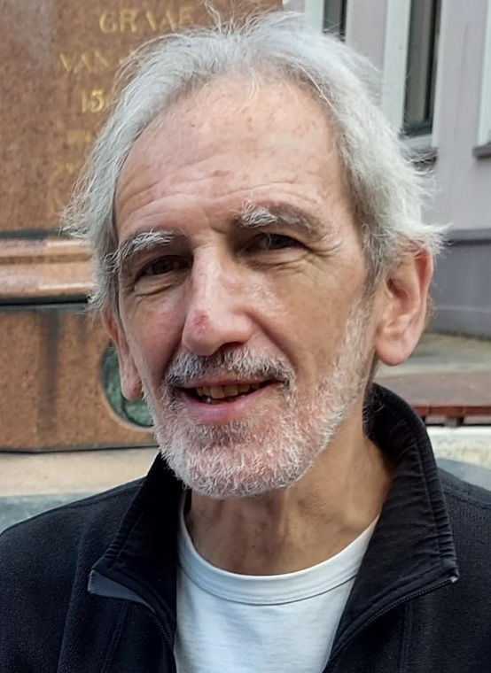
2024 Class A1 – Humanities Section – History & Archaeology
Antoon De Baets University of Groningen The Netherlands | Attacks on history History of history Abuses of history Censorship of history Theory of history History and human rights Ethics of historians

Slide 6
2024 Class A1 – Humanities Section – History & Archaeology
Ewa Domanska Adam Mickiewicz University Poznań Poland | Methods of historical research Environmental humanities Ecocide and genocide studies Human remains as heritage Emerging fields in the humanities and social sciences Non-Western knowledges of the past and ways of knowing Theory and history of historiography Comparative theory of the humanities and social sciences

Slide 7
2024 Class A1 – Humanities Section – History & Archaeology
Peter Frankopan Worcester College Cambridge United Kingdom | Belt and Road Initiative Silk Roads Studies Russia and the former Soviet Union Histories of China Central Asia Urbanization & nomadism Middle Eastern affairs Byzantine empire Climate change & the natural world

Slide 8
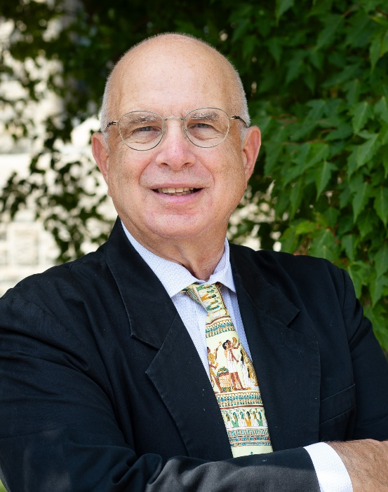
2024 Class A1 – Humanities Section – History & Archaeology
Haskel Greenfield University of Manitoba Winnipeg Canada | Evolution of food producing and farming societies Evolution of metallurgical technology Evolution of early complex and urban societies Origins of pastoralism Origins of food production Old World archaeology Origins of metallurgy Zooarchaeology Archaeology of Europe, Near East and Africa Origins of animal domestication

Slide 9
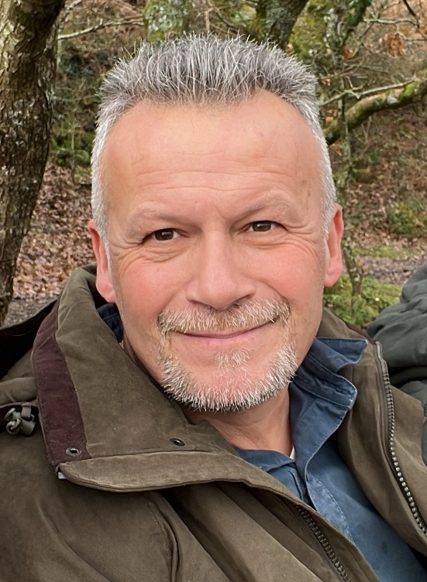
2024 Class A1 – Humanities Section – History & Archaeology
Timothy Insoll University of Exeter United Kingdom | African archaeology Islamic archaeology Archaeology of religion

Slide 10
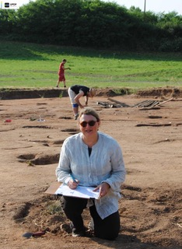
2024 Class A1 – Humanities Section – History & Archaeology
Sophie Krausz Université Paris 1 Panthéon Sorbonne Paris France | Large-scale field archaeological projects Fortifications Continental Europe Emergence of the state Political systems Iron Age, Prehistory Celts Urbanisation Archaeological concomitants of peace and war Protohistoric and later Mediterranean civilisations

Slide 11
2024 Class A1 – Humanities Section – History & Archaeology
Tijana Krstic Central European University Vienna Austria | Religious conversion Comparative study of empires in early modern Eurasia Cultural, religious, and intellectual history of the early modern Ottoman Empire Islamic intellectual history Early modern Mediterranean history

Slide 12
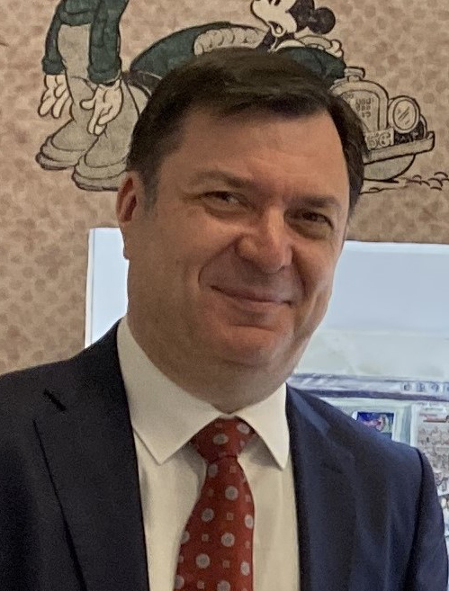
2024 Class A1 – Humanities Section – History & Archaeology
Slobodan Markovich University of Belgrade Serbia | History of European pessimism Psychoanalytic anthropology Western perceptions of the Balkans Cultural transfer Europe – the Balkans History of psychoanalysis British-Balkan relations since the Napoleonic Wars

Slide 13
2024 Class A1 – Humanities Section – History & Archaeology
Matthias Middell Leipzig University Germany | Global studies History Political geography

Slide 14
2024 Class A1 – Humanities Section – History & Archaeology
Luisa Migliorati Sapienza Università di Roma Italy | Heritage buildings Mexico colonial urbanism Ancient topography Ancient cartography Ancient urbanism Ancient architecture

Slide 15
2024 Class A1 – Humanities Section – History & Archaeology
Felicitas Schmieder FernUniversität in Hagen Germany | Europe and the Mongols in the Middle Ages Medieval Europe Medieval cultural contacts Medieval prophecy Medieval German urban history Medieval/ early modern cartography

Slide 16
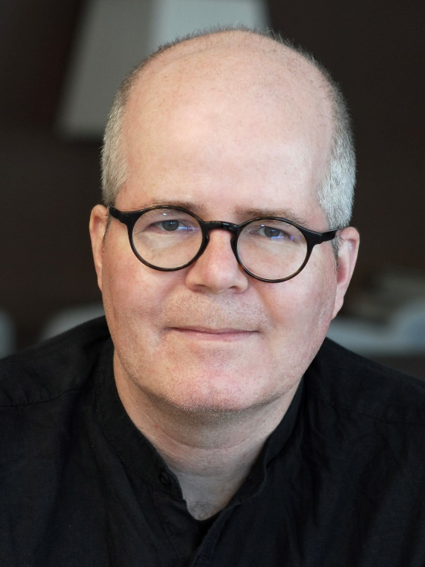
2024 Class A1 – Humanities Section – History & Archaeology
Daniel Siemens Newcastle University United Kingdom | Political history History of religion History of violence Politics of the past Intellectual history History of law History of reparations National Socialism

Slide 17
2024 Class A1 – Humanities Section – History & Archaeology
Matthew Spriggs The Australian National University Canberra Australia | Cornish language history and Cornish studies Subsistence systems and human-environment interactions History of archaeology Archaeological theory Pacific and Southeast Asian archaeology Archaeology, linguistics and genetics

Slide 18
2024 Class A1 – Humanities Section – History & Archaeology
Philipp Stockhammer Ludwig Maximilian University of Munich Germany | Bioarchaeology Prehistory Mediterranean Ancient DNA Near East Archaeology Europe

Slide 19
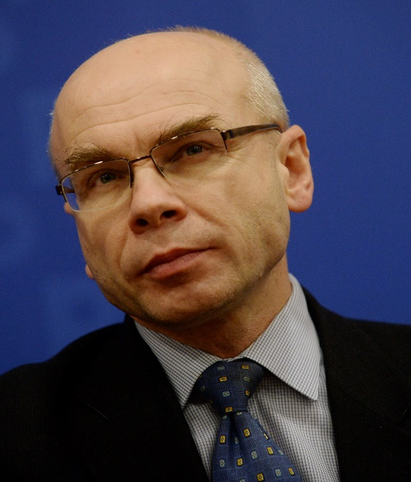
2024 Class A1 – Humanities Section – History & Archaeology
Dariusz Stola Polish Academy of Sciences Warsaw Poland | History of transnational migrations Contemporary history of Poland History of Polish-Jewish relations Holocaust History of communist regimes

Slide 20
2024 Class A1 – Humanities Section – Classics & Oriental Studies
Overall section members: 171 Overall foreign members: 9 Overall female members: 45

Slide 21
2024 Class A1 – Humanities Section – Classics & Oriental Studies
Jens Braarvig Norwegian Institute of Philology Oslo Norway | History and languages of Buddhism Paleography History of religion/culture Textual criticism Sanskrit, Tibetan, Chinese History of knowledge Multilingualism in history Comparative philology

Slide 22
2024 Class A1 – Humanities Section – Classics & Oriental Studies
Monica Centanni Università Iuav di Venezia Venice Italy | Iconology and history of art Ancient theatre Classical Tradition Aby Warburg and Mnemosyne Atlas Renaissance studies Transition from Paganism to Christianity, from the Middle Ages to the Renaissance Culture of Late Antiquity (Hellenistic novel)

Slide 23
2024 Class A1 – Humanities Section – Classics & Oriental Studies
Almut Hintze University of London United Kingdom | Multimedia and virtual reality documentation of Avestan rituals Electronic corpora and manuscript analysis Ritual studies and theory Sustainable long-term and standards-based hosting and preservation of digital data Multimedia language documentation Minority cultures and religions and languages in Iran and India, especially Zoroastrianism Sasanian seals and Middle Persian epigraphy Historical and comparative philology and linguistics of ancient Indo-Iranian languages

Slide 24
2024 Class A1 – Humanities Section – Classics & Oriental Studies
Arlene Holmes Henderson Durham University United Kingdom | Public policy Social mobility Classics education Languages in education Public engagement Employability Rhetoric Critical skills Humanities in education

Slide 25
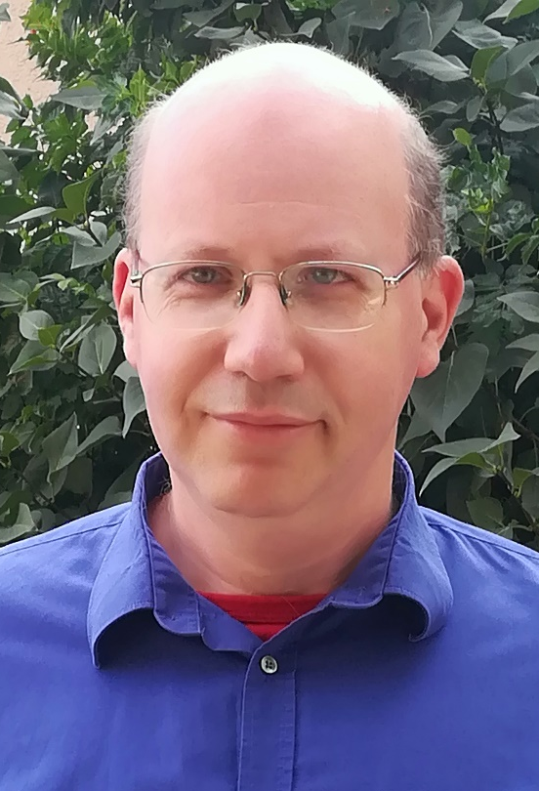
2024 Class A1 – Humanities Section – Classics & Oriental Studies
Gábor Kósa Eötvös Loránd University Budapest Hungary | Manichaeism Cosmogonic myths Shamanism Chinese religions

Slide 26
2024 Class A1 – Humanities Section – Classics & Oriental Studies
Enrico Morano SOAS University of London United Kingdom | Manichaeism Middle Iranian languages Iranian epigraphy Old Iranian languages Classics

Slide 27
2024 Class A1 – Humanities Section – Classics & Oriental Studies
Nils Arne Pedersen Aarhus University Denmark | Patristics Christian Orient Manichaeism Church history Reception of Bible

Slide 28
2024 Class A1 – Humanities Section – Classics & Oriental Studies
Federico Santangelo Newcastle University United Kingdom | History of ancient historiography History of classical scholarship Roman history Hellenistic history History of ancient Italy

Slide 29
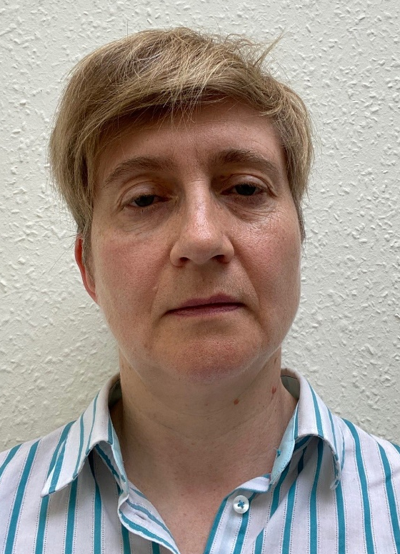
2024 Class A1 – Humanities Section – Classics & Oriental Studies
Catherine Steel University of Glasgow United Kingdom | Cicero Roman oratory Late Roman Republican history

Slide 30
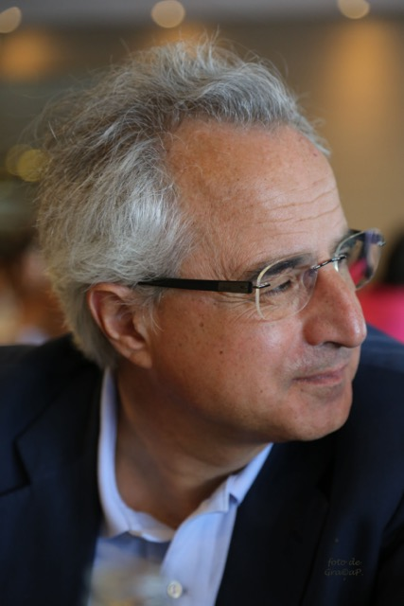
2024 Class A1 – Humanities Section – Classics & Oriental Studies
Mauro Tulli Università di Pisa Italy | Platonic studies Greek Epic poetry Ancient rhetoric Papyrology Hellenistic philosophy

Slide 31
2024 Class A1 – Humanities Section – Classics & Oriental Studies
Sophia Xenophontos Aristotle University of Thessaloniki Greece | Reception of the classical tradition in Byzantium and the Modern Greek Enlightenment Greek literature of the 1st and 2nd century CE Plutarch: biography, popular philosophy, moralising techniques History of medical deontology in antiquity Intellectual history and history of ideas in antiquity and the medieval period History of emotions and psychotherapy Commentary tradition especially on Aristotle’s works Edition, textual criticism and translation of ancient and Byzantine texts Galen: interplay between medicine and practical philosophy, the social role of philosophy

Slide 32
2024 Class A1 – Humanities Section – Linguistic Studies
Overall section members: 235 Overall foreign members: 8 Overall female members: 15

Slide 33
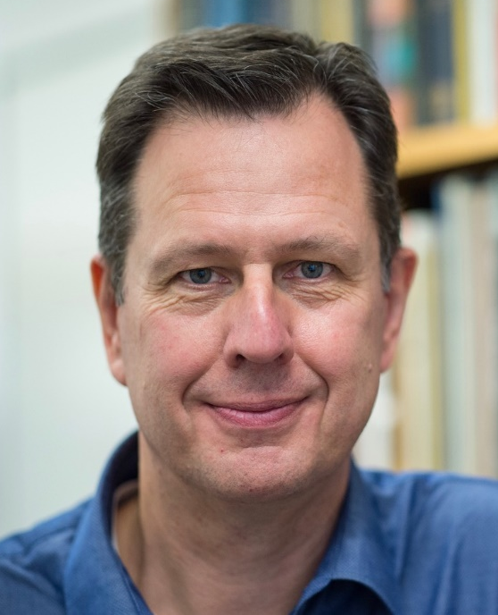
2024 Class A1 – Humanities Section – Linguistic Studies
Bas Aarts University College London United Kingdom | Corpus linguistics Syntax Linguistic usage Language change English grammar Language teaching and pedagogy

Slide 34
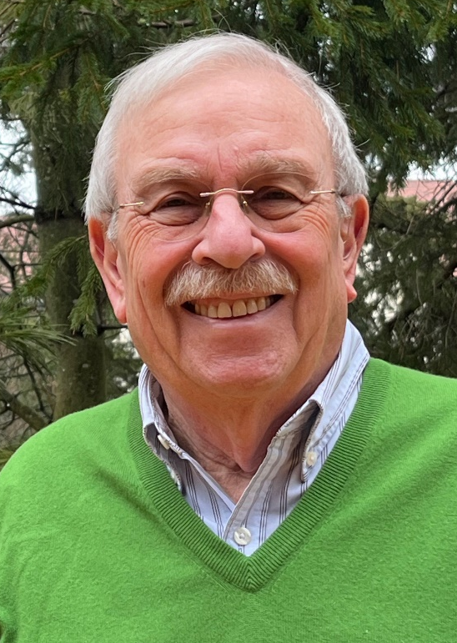
2024 Class A1 – Humanities Section – Linguistic Studies
Mark Aronoff Stony Brook University USA | Linguistic morphology Sign language Writing systems Teaching linguistics

Slide 35
2024 Class A1 – Humanities Section – Linguistic Studies
Matthew Baerman University of Surrey Guildford United Kingdom | Historical linguistics Linguistic typology Linguistic morphology

Slide 36
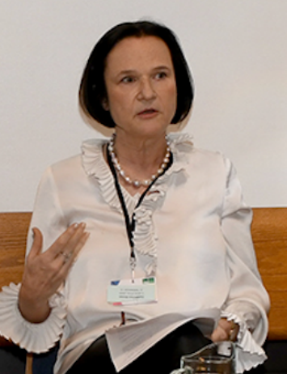
2024 Class A1 – Humanities Section – Linguistic Studies
Anna Carlier Sorbonne Université Paris France | Theories of linguistic change Nominal determination Historical linguistics of French Corpus linguistics Comparative linguistics of the Romance languages Aspect, voice, and auxiliaries Morphosyntax Grammatical semantics

Slide 37
2024 Class A1 – Humanities Section – Linguistic Studies
Ewa Dąbrowska Friedrich Alexander Universität Erlangen-Nürnberg Germany | Language aptitude Cognitive linguistics Artificial language learning Language and cognition Usage based approaches Individual differences in linguistic knowledge Language processing Language acquisition

Slide 38
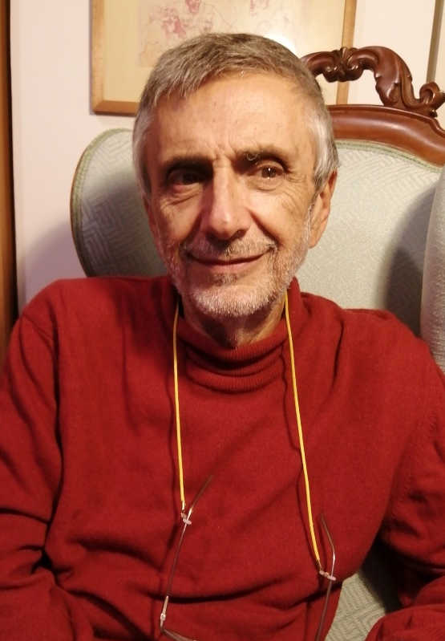
2024 Class A1 – Humanities Section – Linguistic Studies
Franco Fanciullo University of Pisa Italy | Languages in contact in the Mediterranean Sea during the Middle Ages Italian and dialectal etymology Italian and Greek linguistics Italian dialectology Historical linguistics

Slide 39
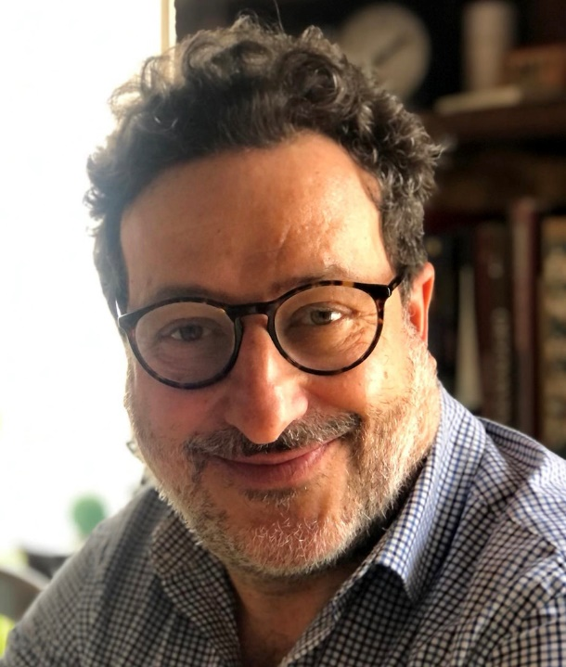
2024 Class A1 – Humanities Section – Linguistic Studies
Livio Gaeta University of Turin Italy | Contrastive linguistics Linguistic minorities German and Germanic linguistics Theoretical linguistics: morphology and word-formation Language contact Language change and grammaticalization Cognitive linguistics Italian and Romance linguistics

Slide 40
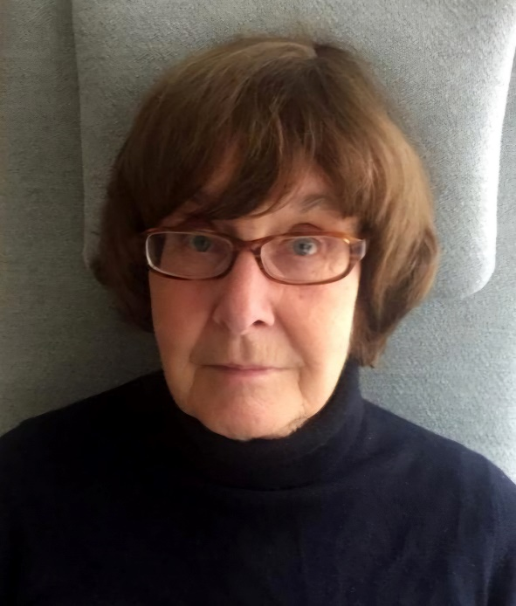
2024 Class A1 – Humanities Section – Linguistic Studies
Juliane House Universität Hamburg Germany | Applied linguistics English as a Lingua Franca Translation theory and criticism Discourse analysis Second language acquisition Cross-cultural pragmatics Politeness

Slide 41
2024 Class A1 – Humanities Section – Linguistic Studies
Guillaume Jacques CNRS (Centre national de la recherche scientifique) Paris France | Archaeolinguistics Linguistic typology Historical linguistics (Sino-Tibetan, Indo-European, Algonquian) Language documentation (Rgyalrongic, Kiranti)

Slide 42
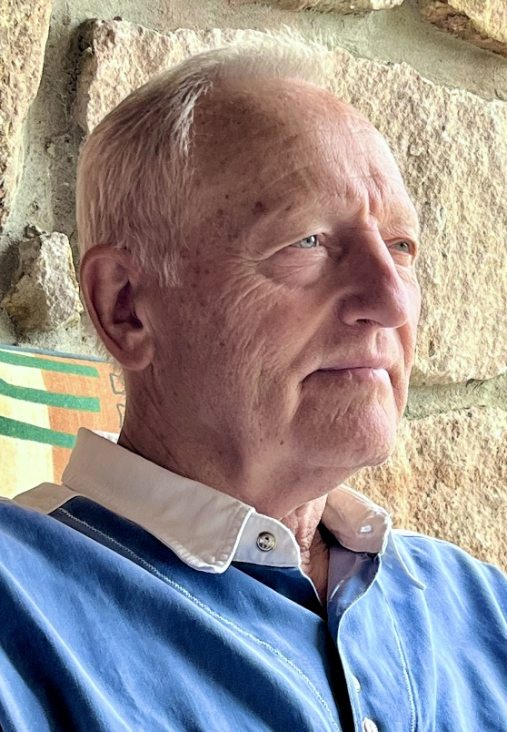
2024 Class A1 – Humanities Section – Linguistic Studies
Zoltán Kövecses Eötvös Loránd University Budapest Hungary | Universality and variation in metaphor Language of emotions American English Theory of metaphor and metonymy Lexicography

Slide 43
2024 Class A1 – Humanities Section – Linguistic Studies
Aylin Küntay Koç University Istanbul Turkey | Communicative development Gestures Bilingualism and heritage languages Social robots in educational use Psycholinguistics Child language development

Slide 44
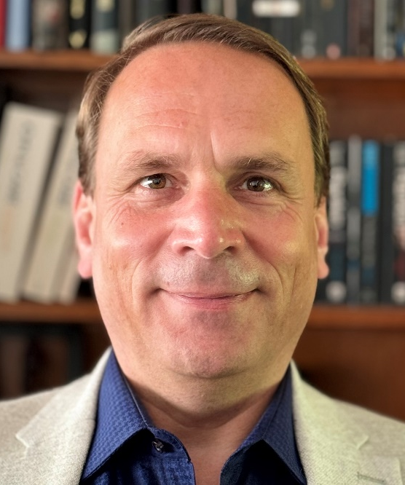
2024 Class A1 – Humanities Section – Linguistic Studies
Lutz Marten University of London United Kingdom | Area studies Bantu languages African languages Comparative and historical linguistics Swahili Linguistics

Slide 45
2024 Class A1 – Humanities Section – Linguistic Studies
Eugen Munteanu Romanian Academy Iassy Romania | General linguistics and theory of language Language contacts and traductology History of linguistic ideas Biblical studies Philosophy of language Romanian philology Semantics Lexicography Classical philology

Slide 46
2024 Class A1 – Humanities Section – Linguistic Studies
Janet Pierrehumbert University of Oxford United Kingdom | Speech technology Phonology Language processing Morphology Sound change Computational linguistics Language modeling

Slide 47
2024 Class A1 – Humanities Section – Linguistic Studies
Gábor Prószéky HUN-REN Hungarian Research Centre for Lingusitics Budapest Hungary | Computational lexicography Computational morphology Terminology Large language models Machine translation

Slide 48
2024 Class A1 – Humanities Section – Linguistic Studies
Josep Quer ICREA-Pompeu Fabra University Barcelona Spain | Greek Syntax Semantics Sign languages Romance languages

Slide 49
2024 Class A1 – Humanities Section – Linguistic Studies
Malka Rappaport Hovav The Hebrew University of Jerusalem Israel | Polysemy Argument structure Syntax Event semantics Lexical semantics Lexical and grammatical aspect Semantics-cognition interface Morphology

Slide 50
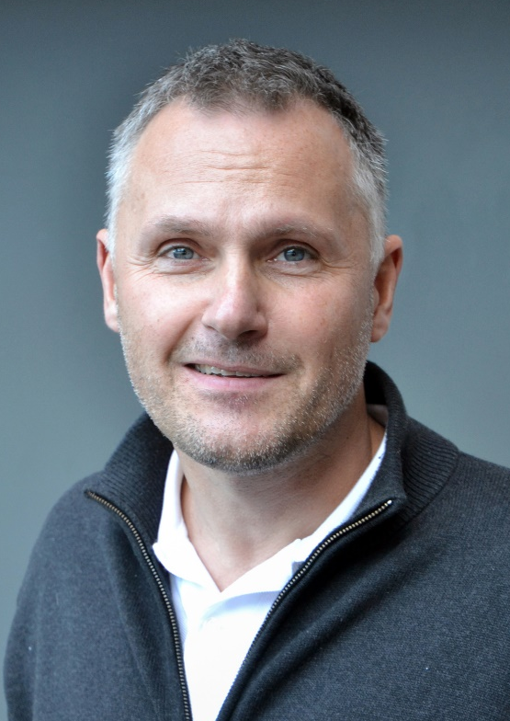
2024 Class A1 – Humanities Section – Linguistic Studies
Michael Schulte University of Agder Kristiansand Norway | Comparative linguistics Writing system research (Runes) Formulaic language (Runic inscriptions) Runic inscriptions (Runology) Language history (Nordic) Metrical studies of Old Germanic Sociocultural history (Nordic) Proto-Norse Germanic philology Old Norse

Slide 51
2024 Class A1 – Humanities Section – Linguistic Studies
Heike Wiese Humboldt-Universität zu Berlin Germany | Grammar and lexicon Linguistic architecture Linguistic variation and contact Language attitudes and ideologies

Slide 52
2024 Class A1 – Humanities Section – Literary & Theatrical Studies
Overall section members: 230 Overall foreign members: 22 Overall female members: 80

Slide 53
2024 Class A1 – Humanities Section – Literary & Theatrical Studies
Ruxandra Cesereanu Babes-Bolyai University Cluj-Napoca Romania | World literature Imagination studies Film studies Comparative literature Political and historical studies - Gulag and Holocaust Mentality studies

Slide 54
2024 Class A1 – Humanities Section – Literary & Theatrical Studies
Nicholas Cronk University of Oxford United Kingdom | Enlightenment thought Voltaire 18th-century history of the book Digital Humanities 18th-century French literature 18th-century correspondence

Slide 55
2024 Class A1 – Humanities Section – Literary & Theatrical Studies
Helena Duffy University of Wrocław Poland | Postmodernism Holocaust literature and cinema French and comparative literature Posthumanism (ecocriticism and human-animal studies)

Slide 56
2024 Class A1 – Humanities Section – Literary & Theatrical Studies
Frode Helland University of Oslo Norway | Ibsen-studies Racism Holocaust-studies Literature Rhetoric

Slide 57
2024 Class A1 – Humanities Section – Literary & Theatrical Studies
Tatjana Jukić University of Zagreb Croatia | English literature (19th and 20th centuries) Semiotics Comparative literature Film and visual arts European cultural history Social philosophy

Slide 58
2024 Class A1 – Humanities Section – Literary & Theatrical Studies
Markus Messling Universität des Saarlandes Saarbrücken Germany | Comparative literature and cultural philosophy French and Francophone literatures Epistemology and history of the modern humanities Historical anthropology Narration and historiography Aesthetics Mediterranianism Universalism/relativism The irreparable and theories of reparation/repair

Slide 59
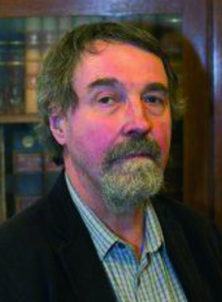
2024 Class A1 – Humanities Section – Literary & Theatrical Studies
Martin Procházka Charles University Prague Czech Republic | Intercultural communication American colonial literature Comparative literature Scottish literature Romanticism

Slide 60
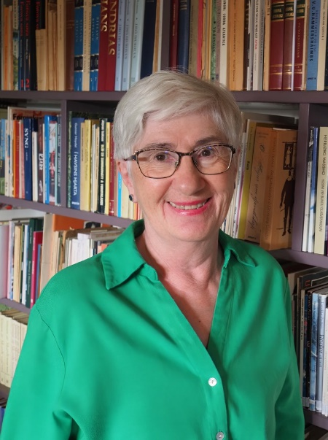
2024 Class A1 – Humanities Section – Literary & Theatrical Studies
Turið Sigurðardóttir University of the Faroe Islands Torshavn Faroe Islands | Icelandic literature Translation Faroese literature

Slide 61
2024 Class A1 – Humanities Section – Literary & Theatrical Studies
Carlos Spoerhase Ludwig-Maximilians-Universität München Germany | Sociology of literature in the global literary field Literary theory and general criticism Relationship between aesthetics and social theory History of the humanities Modern German and European literary history Modern German and European intellectual history Methods and practices of philological research

Slide 62
2024 Class A1 – Humanities Section – Literary & Theatrical Studies
Anne Tomiche Sorbonne Université Paris France | Experiments in art in the 20th century Gender studies Comparative literature Modernisms, modernities, avant-gardes Philosophy (deconstruction) and literature

Slide 63
2024 Class A1 – Humanities Section – Literary & Theatrical Studies
Carlo Vecce University of Naples L'Orientale Naples Italy | Renaissance literature and civilization Italian literature from Middle Age to Modernity History of books and libraries Transmission of texts in Middle Ages and Renaissance Intercultural exchanges Intermediality (Literature, Visual Arts, Cinema, Music) Classical and humanist philology Intellectual workshops in Modern Age

Slide 64
2024 Class A1 – Humanities Section – Literary & Theatrical Studies
Eva von Contzen Albert-Ludwigs-Universität Freiburg Germany | Narratology Hagiography History of reception Re-telling Medieval English studies

Slide 65
2024 Class A1 – Humanities Section – Musicology & Art History
Overall section members: 152 Overall foreign members: 9 Overall female members: 38

Slide 66
2024 Class A1 – Humanities Section – Musicology & Art History
Barbara Arciszewska University of Warsaw Poland | Court studies Early modern history Architectural theory Architectural history Art theory Gender studies Art history

Slide 67
2024 Class A1 – Humanities Section – Musicology & Art History
Wojciech Bałus Jagiellonian University Kraków Poland | History of modern art and architecture History of art theory Methodology of art history and Bildwissenschaft Theory and history of stained-glass

Slide 68
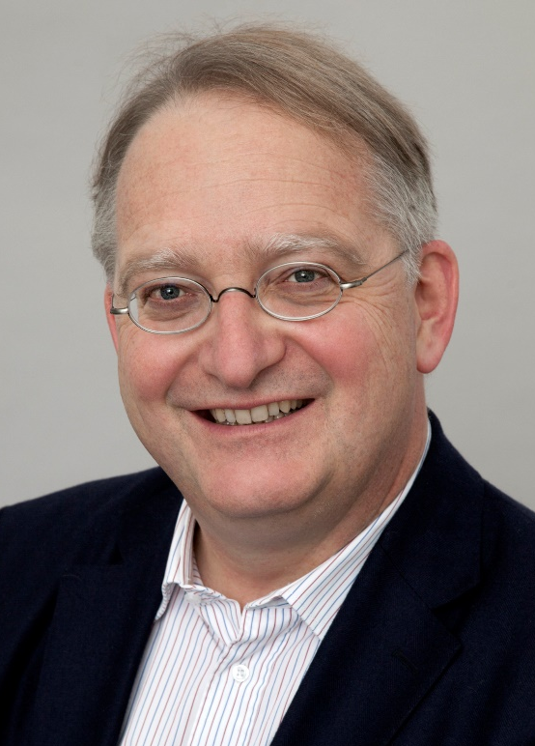
2024 Class A1 – Humanities Section – Musicology & Art History
Gerd Blum University of Fine Arts Münster Germany | Non-figurative Modernist Art and its reception since 1980 Beginnings of Modernist Painting (Marées; Manet) Views and Site-Specificity in Early Modern Architecture Early modern theory of architecture Reception history of the Tabernacle Narrative of Schemot Early modern historiography of art Exodus in Early Modern Art and texts on Art (Ark of the Covenant; Bezalel; Moses) How form becomes formula and stereotype, from 1500 to present

Slide 69
2024 Class A1 – Humanities Section – Musicology & Art History
Diane Bodart Columbia University New York USA | Image theory and artistic practice in Renaissance and Baroque Italy Art History Renaissance Venice Art and Politics in the Spanish Habsburg Empire

Slide 70
2024 Class A1 – Humanities Section – Musicology & Art History
Massimo Leone Università di Torino Italy | Theoretical frameworks for modeling cultural change in semiotic terms Art history Digital evolution of visual cultures

Slide 71
2024 Class A1 – Humanities Section – Musicology & Art History
Emilio Sala University of Milan Italy | Opera studies Film music studies Pre-cinematic listening

Slide 72
2024 Class A1 – Humanities Section – Philosophy, Theology & Religious Studies
Overall section members: 155 Overall foreign members: 5 Overall female members: 45

Slide 73
2024 Class A1 – Humanities Section – Philosophy, Theology & Religious Studies
Monika Betzler Ludwig Maximilian University Munich (LMU) Germany | Normative ethics Metanormative theory Moral psychology Ethics of personal relationships Philosophy of agency

Slide 74
2024 Class A1 – Humanities Section – Philosophy, Theology & Religious Studies
Robert Gordon St Catharine's College Cambridge United Kingdom | Hebrew Bible/Old Testament Hebrew Bible in Jewish and Christian tradition Hebrew Bible and its ancient versions in Greek, Aramaic, Syriac, Latin Biblical Exegesis and theology Ancient Near Eastern context of the Hebrew Bible

Slide 75
2024 Class A1 – Humanities Section – Philosophy, Theology & Religious Studies
Joost Joosten University of Barcelona Spain | Proof theory Formal logic Logic in AI and law Metamathematics

Slide 76
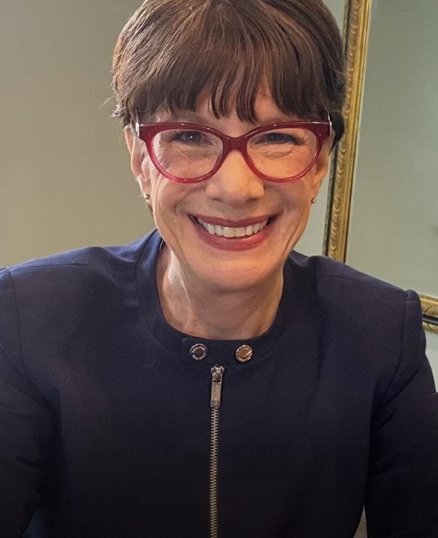
2024 Class A1 – Humanities Section – Philosophy, Theology & Religious Studies
Amy-Jill Levine Vanderbilt University Nashville USA | Christian origins Jewish-Christian relations Sexuality Second Temple Judaism Religion Gender

Slide 77
2024 Class A1 – Humanities Section – Philosophy, Theology & Religious Studies
Christoph Lüthy Radboud University Nijmegen The Netherlands | History of matter theories History of philosophy, notably 1500-1800 History and logic of scientific imagery (diagrams, models, graphs, emblems, etc.) Theories of chance History of science, notably Scientific Revolution History of the philosophy of mind

Slide 78
2024 Class A1 – Humanities Section – Philosophy, Theology & Religious Studies
Teresa Marques University of Barcelona Spain | Philosophy of language Conceptual engineering Epistemology Feminist and social philosophy Hate speech Metaethics

Slide 79
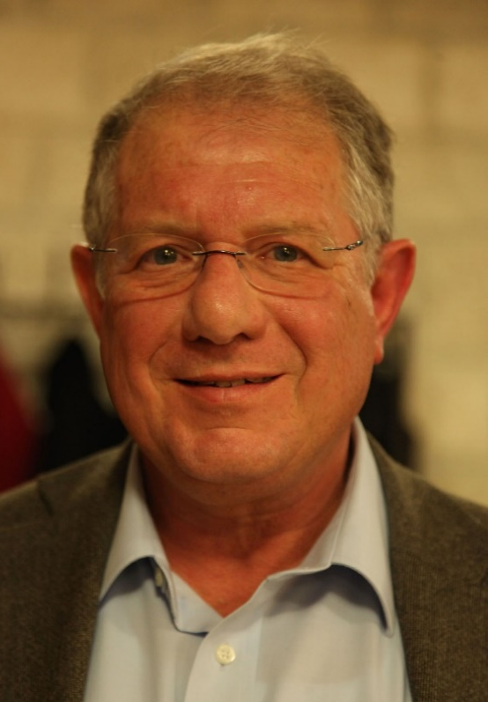
2024 Class A1 – Humanities Section – Philosophy, Theology & Religious Studies
Guy Stroumsa The Hebrew University of Jerusalem Israel | Comparative religion Religion in Late Antiquity History and historiography of the Study of Religion in Modern Times

Slide 80
2024 Class A1 – Humanities Section – Film, Media & Visual Studies
Overall section members: 116 Overall foreign members: 7 Overall female members: 54

Slide 81
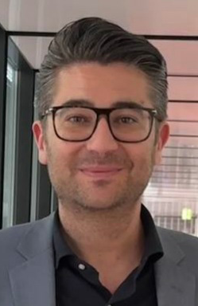
2024 Class A1 – Humanities Section – Film, Media & Visual Studies
Gabriele Balbi USI Università della Svizzera italiana Lugano Switzerland | Political economy of communication Media history Science and technology studies Media archaeology Communication history

Slide 82
2024 Class A1 – Humanities Section – Film, Media & Visual Studies
Anne Kaun Södertörn University Stockholm Sweden | Automation and artificial intelligence from a humanistic social science perspective Algorithmic culture Media theory Mediated temporalities Political mobilization and social media

Slide 83
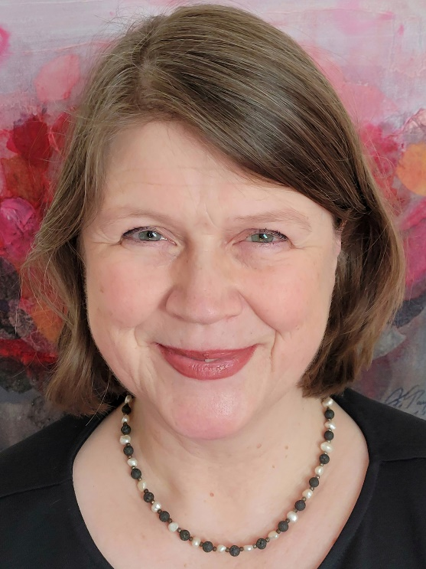
2024 Class A1 – Humanities Section – Film, Media & Visual Studies
Susanne Kinnebrock Augsburg University Germany | Media change and transformations of the Public Sphere (since the 19th Century) Journalism (narrative journalism, convergent journalism) Gender media studies European communication history Health and science communication

Slide 84
2024 Class A1 – Humanities Section – Film, Media & Visual Studies
Margreth Lünenborg Freie Universität Berlin Germany | Affect studies Journalism studies Migration and media Gender media studies Public sphere theory Cultural studies and media research

Slide 85
2024 Class A1 – Humanities Section – Film, Media & visual Studies
Stefania Milan University of Amsterdam The Netherlands | Digital sociology Critical data studies Methodological innovation and computational social science Governance of and by digital technology Data and research ethics

Slide 86
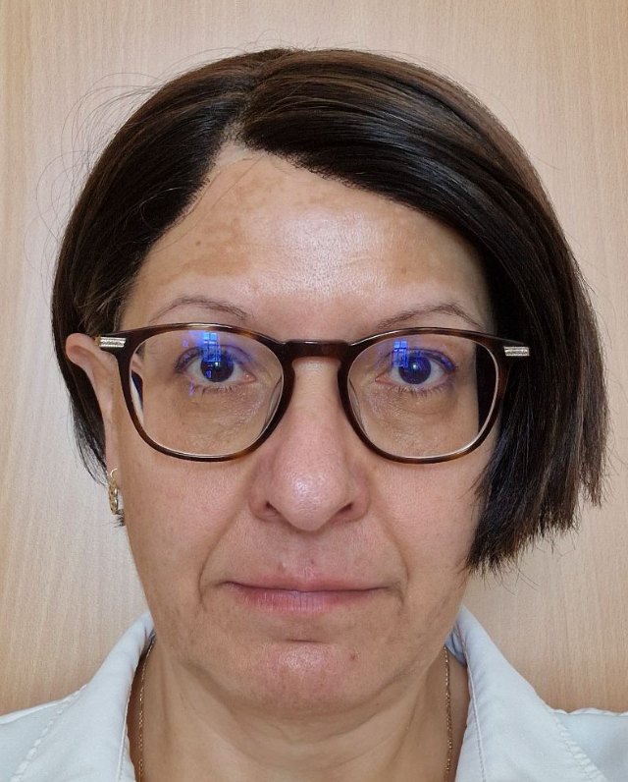
2024 Class A1 – Humanities Section – Film, Media & Visual Studies
Irena Reifová Charles University Prague Czech Republic | Cultural studies Memory studies Post-socialist mediated memory Television studies and visual communication Media studies Qualitative methodology

Slide 87
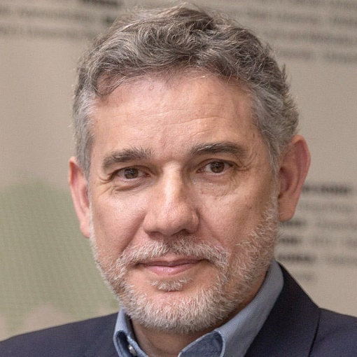
2024 Class A1 – Humanities Section – Film, Media & Visual Studies
Ramón Salaverría University of Navarra Pamplona Spain | Journalism Digital journalism Disinformation

Slide 88
2024 Class A1 – Humanities Section – Film, Media & Visual Studies
Monika Taddicken Technische Universität Braunschweig Germany | Methodology for media and communication research Audience and media effects research Environmental communication Online communication Science communication

Slide 89
2024 Class A1 – Humanities Section – Film, Media & Visual Studies
Patti Valkenburg University of Amsterdam The Netherlands | Well-being Youth Social media Adolescents Media theory Media effects
Technische Universität Braunschweig

Slide 90
2024 Class A1 – Humanities Section – Film, Media & Visual Studies
Barbie Zelizer University of Pennsylvania Philadelphia USA | Memory studies Holocaust War and conflict Visual studies Journalism studies

