Slide 1





Academia Europaea

Slide 2

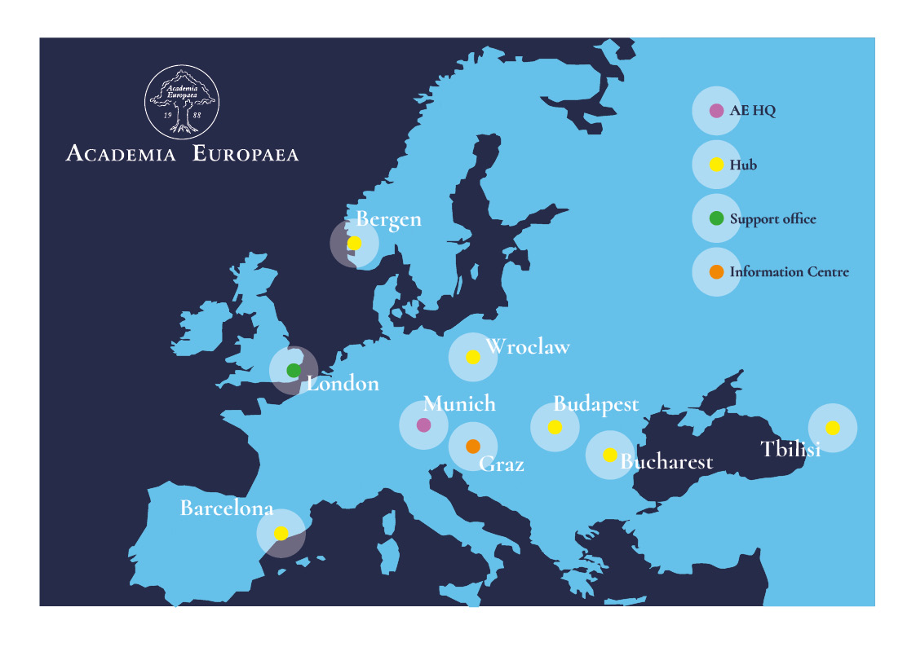
About us
Academia Europaea (AE) was founded in 1988 as an international, nongovernmental association of individual scientists and scholars from all disciplines. Its Members are experts and leaders in their respective fields, as recognised by their peers.
AE is a not-for-profit legal entity registered in the UK (London) and in Germany (Munich). We are funded through our Membersʼ contributions as well as donations from charitable foundations, public organisations and project sponsorship.

Slide 3
Background
Our Articles of Incorporation describe the AE's objectives as:
The advancement and propagation of excellence in scholarship in the humanities, law, the economic, social, and political sciences, mathematics, medicine, and all branches of natural and technological sciences anywhere in the world, for the public benefit and for the advancement of the education of the public of all ages in the aforesaid subjects in Europe.

Slide 4
Our mission
↘ the promotion of excellence in research throughout Europe and elsewhere into the aforesaid subjects,
and the dissemination throughout Europe and elsewhere of the useful results of such research,
↘ the promotion of the development of a European identity in scholarship and research, to conduct analyses of issues relevant to Europe and to act as a European centre for scholars,
↘ the encouragement of interdisciplinary and international studies and research with particular reference to European issues,
↘ the provision of independent advice on matters of scholarly interest or concern to legislatures, governments, universities, the communications media, and to professional, industrial and commercial organisations in Europe,
↘ the encouragement of collaboration between scholars and centres of scholarship in Europe and the promotion of collaboration in education and training,
↘ the organisation and support for conferences, congresses, exhibitions, meetings, lectures, seminars and training courses as the Academy decides.

Slide 5
Strategic Plan Priorities
to recognise and support the development of individual scholarship and scholars,
to deliver collective and independent excellence in expertise and activity,
to create beneficial collaborations and partnerships,
to improve visibility, impact and trust,
to broaden the support base.

Slide 6
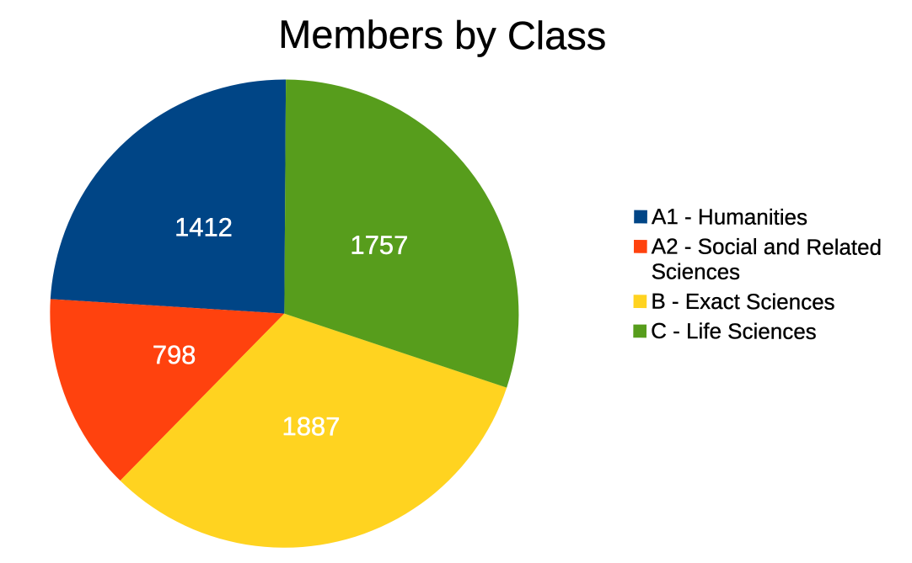

Our Members
Members in 2025, including new MAEs
5854
MAEs represent European scholars’ elite, since 2022 e.g.
7 Nobel Prizes, 3 Fields Medals, 5 Balzan Prizes, 4 L’Oréal-UNESCO For Women in Science Prizes, 4 Wolf Prizes
All in all 88 Nobel Laureates
Diversity growing very slowly
Women: 20,1% (last year 19,7%) – in 1988 18%
Career age: 58% have reached retirement age, 15 under 40
MAE criteria up-dated for next Call according to CoARA principles
Towards qualitative indicators (e.g. significance of research question & scientific impact)
Responsible use of quantitative indicators (e.g. number of publications, IF, H-index & funding)

Slide 7
Key activities
Annual Scientific Meetings
Supporting excellence in scholarship through prizes:
Erasmus Lecture and Medal
    Gold Award
    Adam Kondorosi Prizes
    Sydney Brenner Prize
    Barcelona Hypatia European Science Prize
Science Advice to the European Commission – SAPEA (Science Advice for Policy by European Academies).
From 2024 representing the Commission as the ‘European Academy of Sciences’ in the G-20.
Symposia and working groups
Discipline-specific activities of Classes and their Sections
Cross-disciplinary activities
Publications

Slide 8
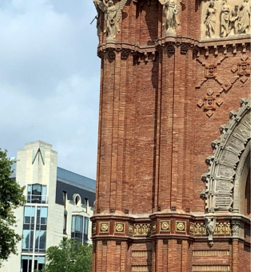
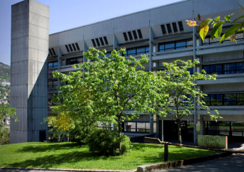
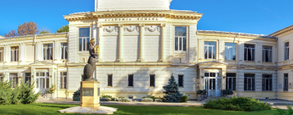
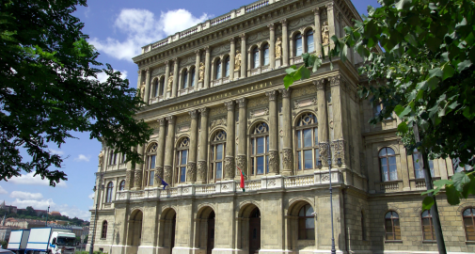
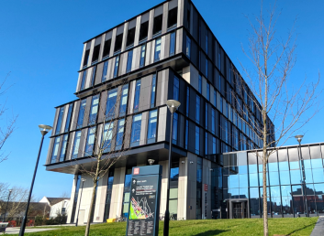
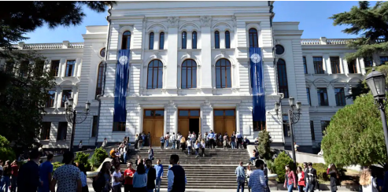
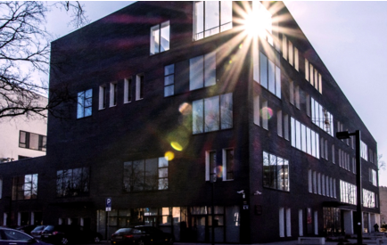
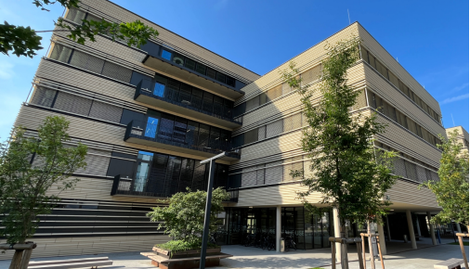
Our regional presence
Barcelona
Bergen
Bucharest
Budapest
Cardiff
Tbilisi
Wroclaw
Graz

Slide 9
Academia Europaea
www.ae-info.org
HQ Office
LMU Munich
Room 334, Theresienstr. 41, 80333 Munich
F.Brandthaus@acadeuro.org +49 89 2180 4294
Support Office
University of London
Room 251, Senate House, Malet Street, London WC1E 7HU
Execsec@acadeuro.org +44 207 862 5784

